Slide 1


Social Network Analysis
&
Community Mining
Group members:周语诠-肖振楚-李波

Slide 2


CONTENTS
01
02
Community Mining
Node Centrality
03
04
Link prediction
Node Classification

Slide 3
Dataset info

Slide 4

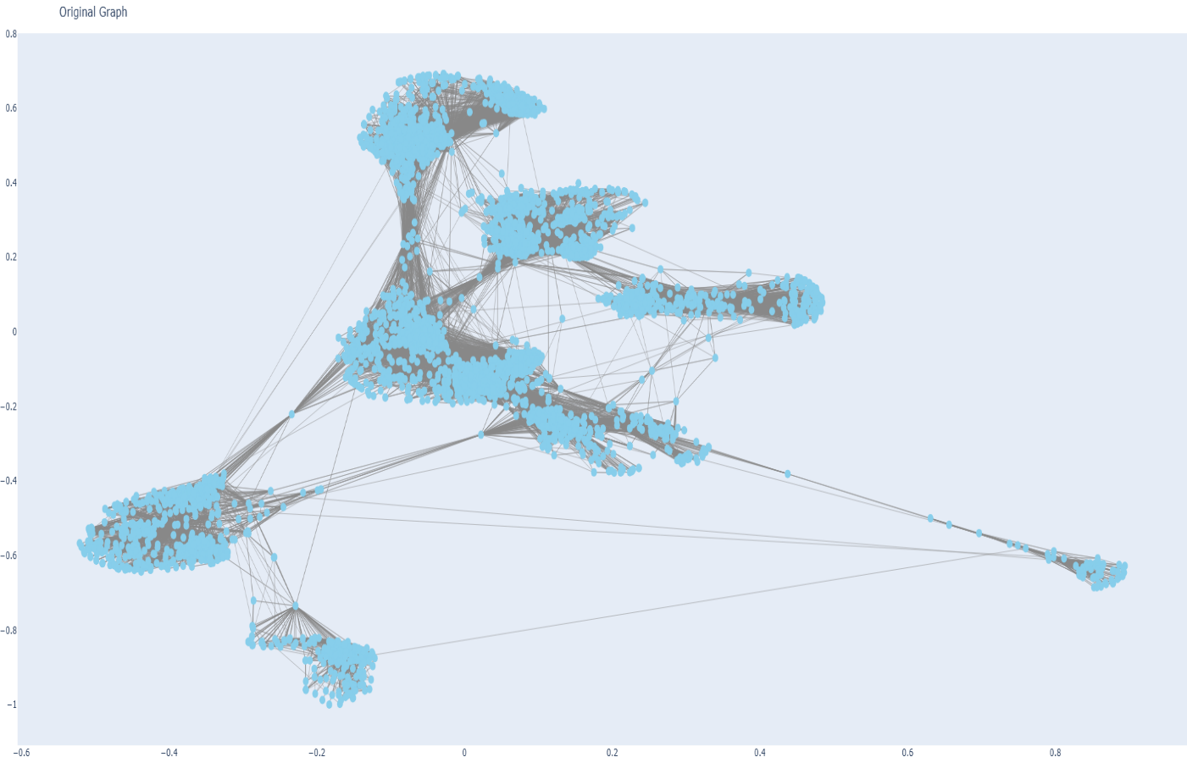
Ego-Facebook Dataset
Dataset statistics
Nodes | 4039
Edges | 88234
Number of triangles | 1612010
Nodes in largest WCC/SCC | 4039
Edges in largest WCC/SCC | 88234
Fraction of closed triangles | 0.2647
Diameter (longest shortest path) | 8
Average clustering coefficient | 0.6055
The network has high clustering, strong connectivity, and many triangles, indicating dense relationships. Its small diameter shows short paths between nodes. These features make it well-suited for community detection and classification.

Slide 5
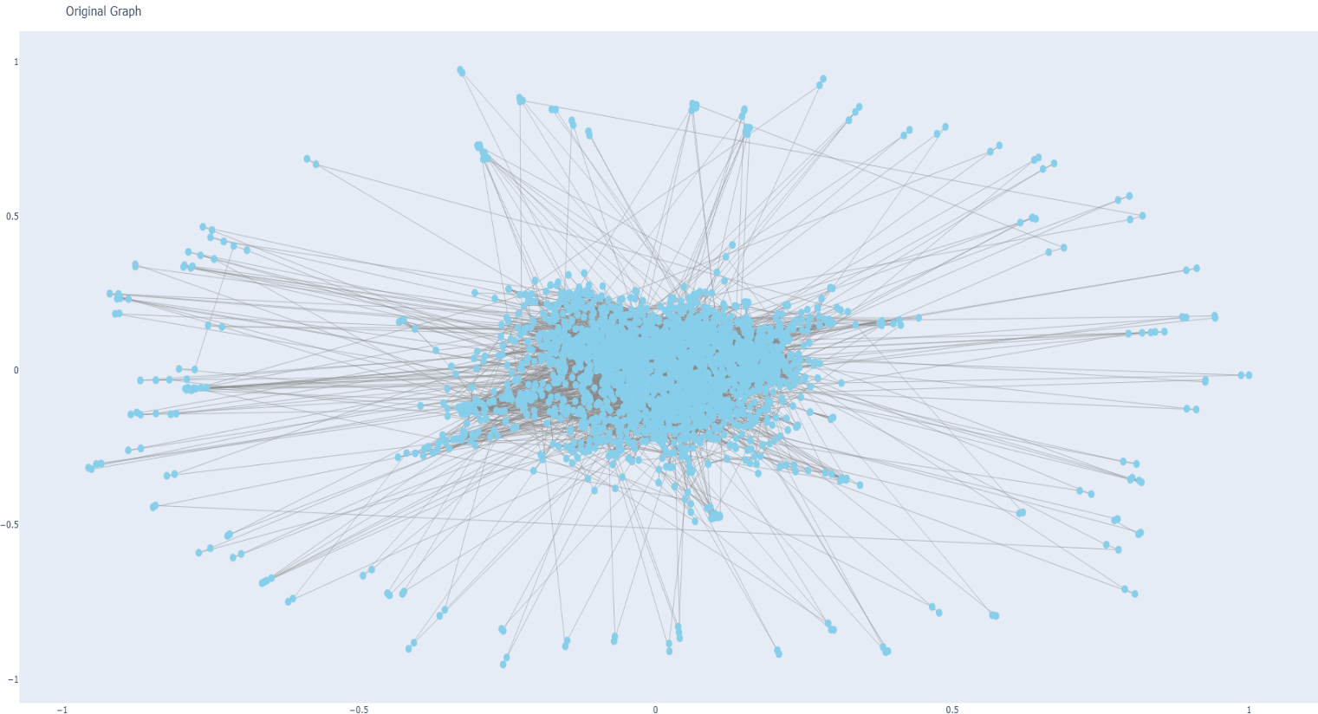
CORA Dataset
Dataset statistics
Nodes | 2708
Edges | 5429
Number of features | 1433
Nodes Categories | 7
Categories: Case_Based, Theory, Rule_Learning, Neural_Networks, Probabilistic_Methods, Genetic_Algorithms, Reinforcement_Learning
The Cora dataset consists of 2708 scientific publications classified into one of seven classes. The citation network consists of 5429 links. Each publication in the dataset is described by a 0/1-valued word vector indicating the absence/presence of the corresponding word from the dictionary. The dictionary consists of 1433 unique words.

Slide 6
Community Mining

Slide 7
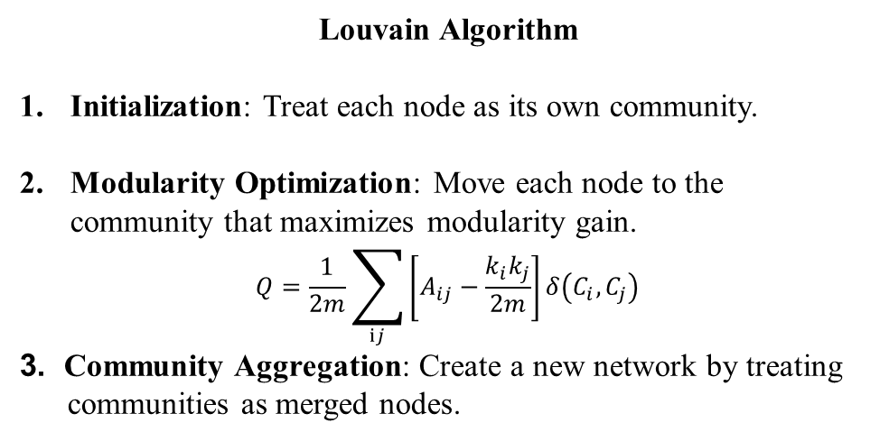
Community Mining
Louvain Algorithm
Initialization: Treat each node as its own community.
Modularity Optimization: Move each node to the community that maximizes modularity gain.
$$Q=\frac{1}{2m}\sum_{ⅈj}{\left[A_{ij}−\frac{k_{i}k_{j}}{2m}\right]}δ\left(C_{i},C_{j}\right)$$
3. Community Aggregation: Create a new network by treating
communities as merged nodes.
Infomap Algorithm
Initialization: Treat each node as an independent
community.
2. Sampling and Assignment: Randomly sample a
sequence of nodes and attempt to assign each node to
the community of its neighbors, aiming for the largest
decrease in average bit value. 3. Stop: Stop when no further decrease in bit value
occurs
Label Propagation
1. Initialization: Treat each node in the graph as an independent
Label Update: For each node, count the communities of its
neighbors and assign the most frequent community to the
node. If there are multiple communities with the same highest
frequency, randomly choose one to assign to the node.
3. Stop: Stop when the community labels of all nodes no longer
change.
Asynchronous Label Propagation
Similar to Label Propagation, the difference is that the former updates all nodes synchronously, while the latter updates only one randomly selected node at a time

Slide 8
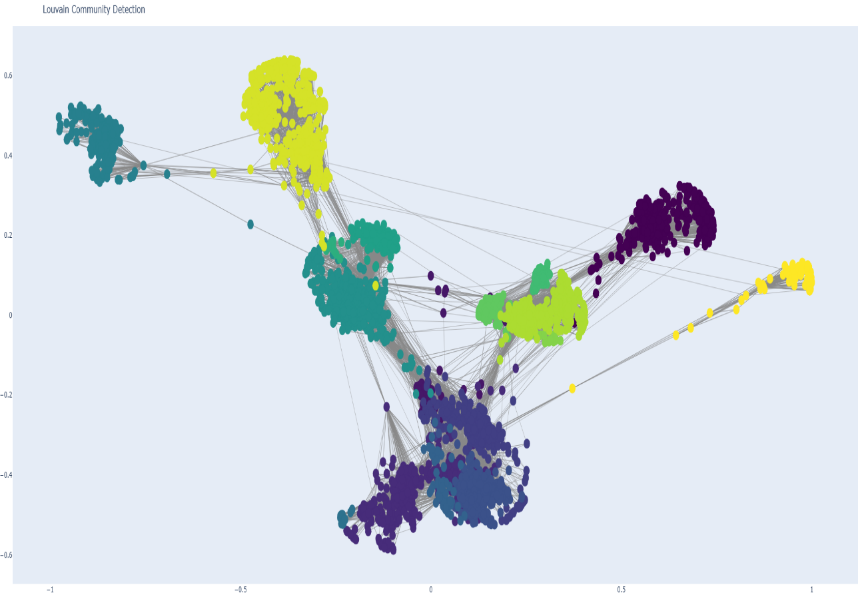
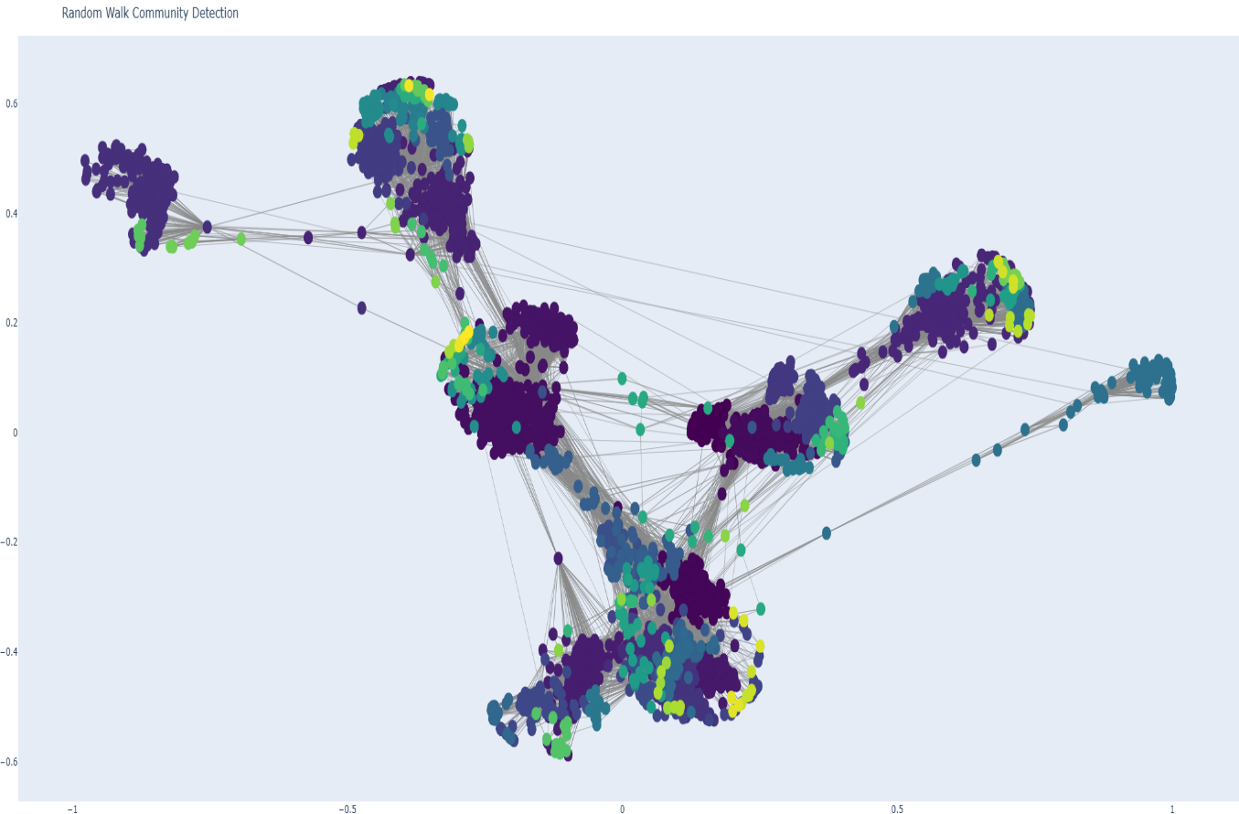
Community Mining
Louvain Algorithm
Number of communities: 17
Modularity: 0.8348897066
Infomap Algorithm
Number of communities: 75
Modularity: 0.8120019909

Slide 9
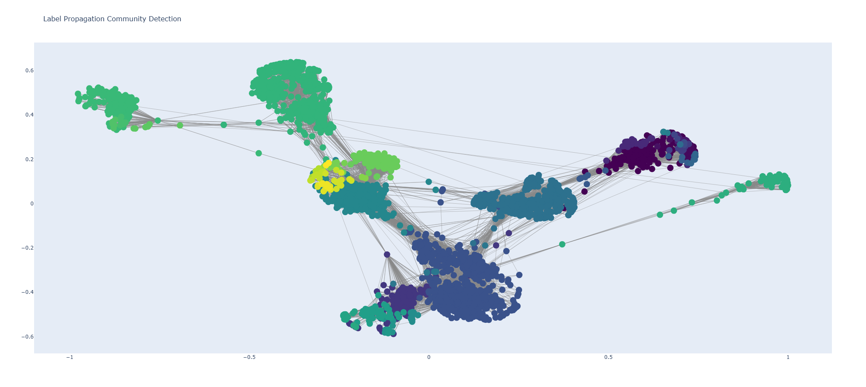
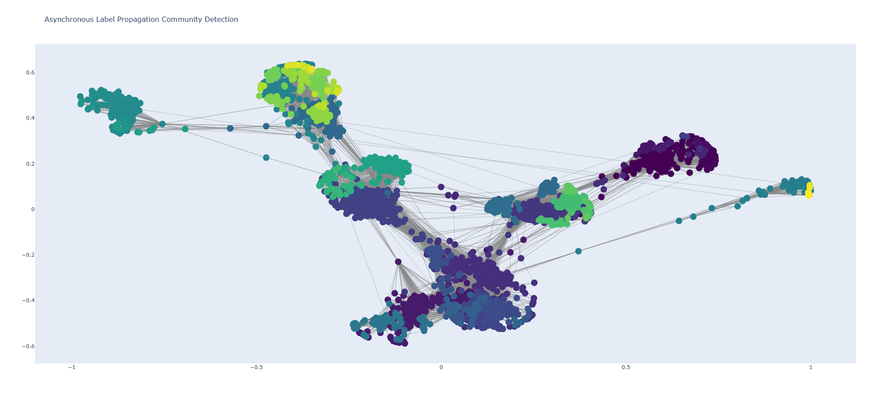
Community Mining
Label Propagation
Number of communities: 44
Modularity: 0.7368407345
Asynchronous Label Propagation
Number of communities: 82
Modularity: 0.8115798727

Slide 10
Node Centrality

Slide 11
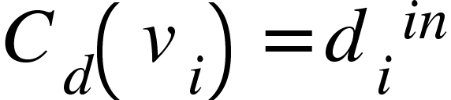
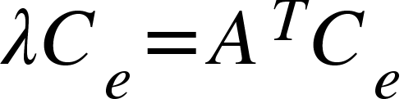
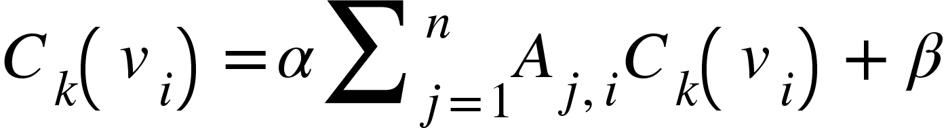
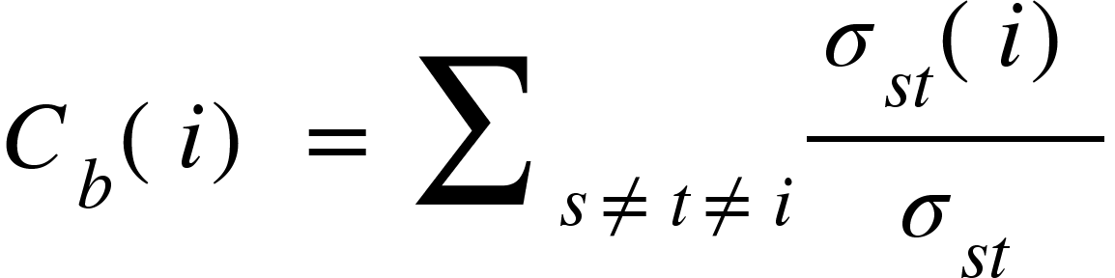
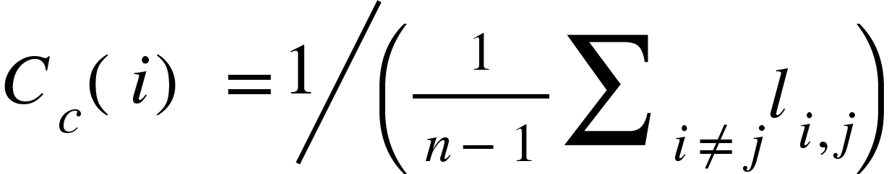
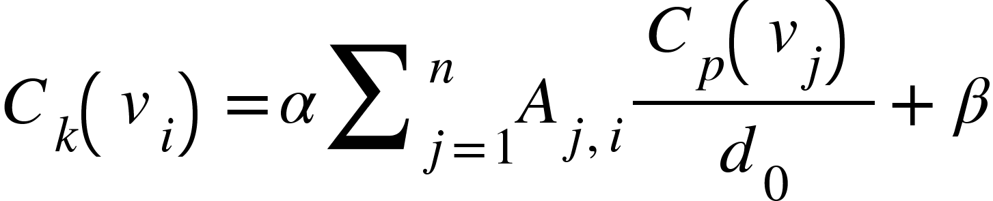
Node Centrality
Degree Centrality
Eigenvector Centrality
Katz Centrality
Between Centrality
Closeness Centrality
Pagerank Centrality

Slide 12
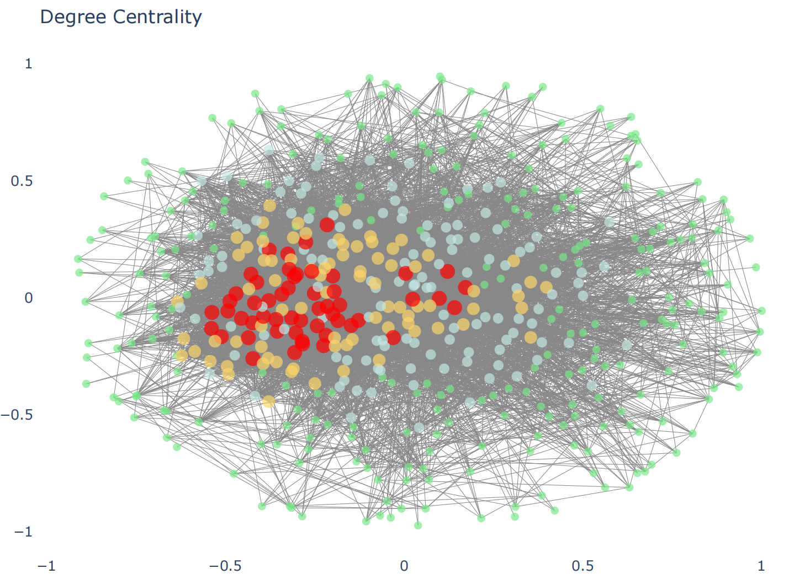
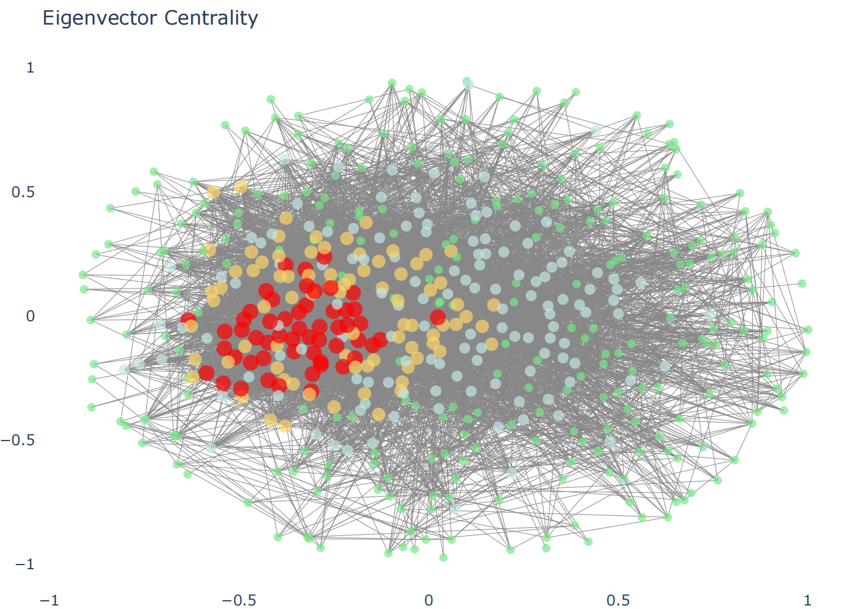
Node Centrality
Degree Centrality
Eigenvector Centrality

Slide 13
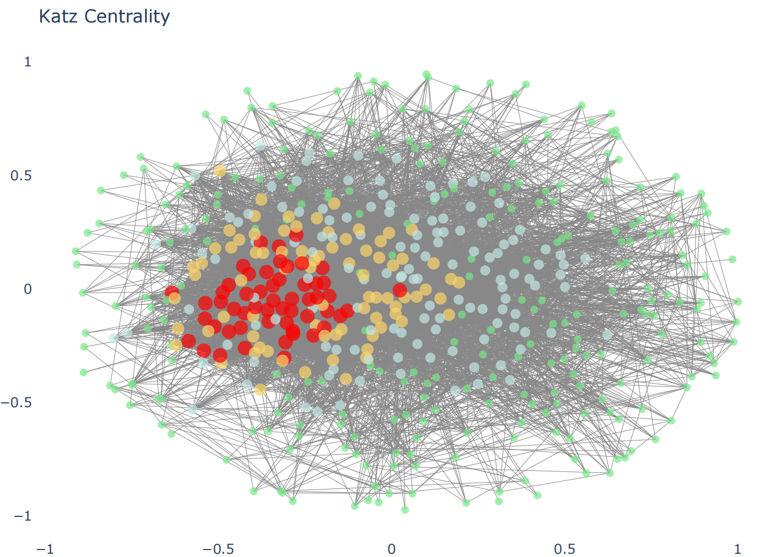
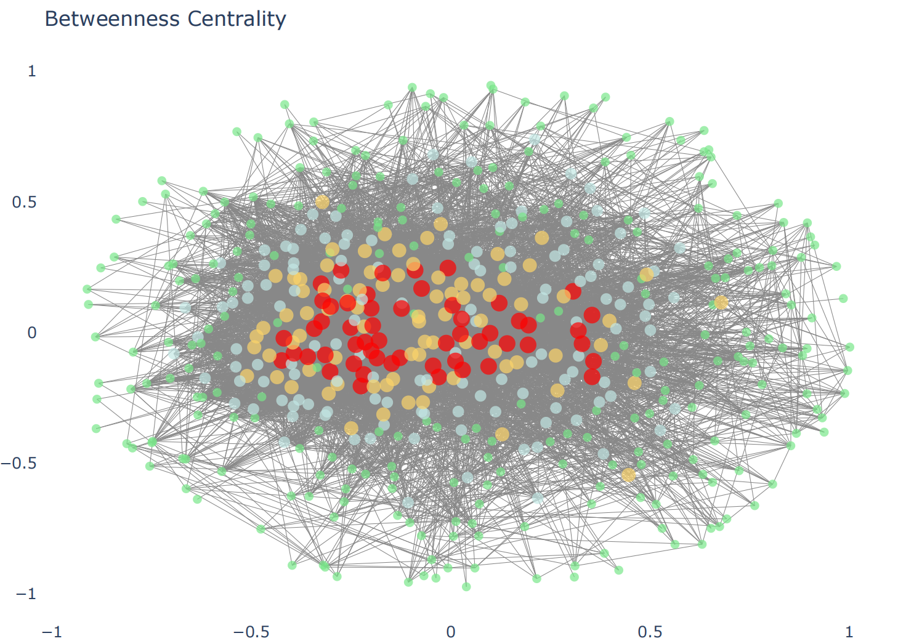
Node Centrality
Katz Centrality
Betweenness Centrality

Slide 14

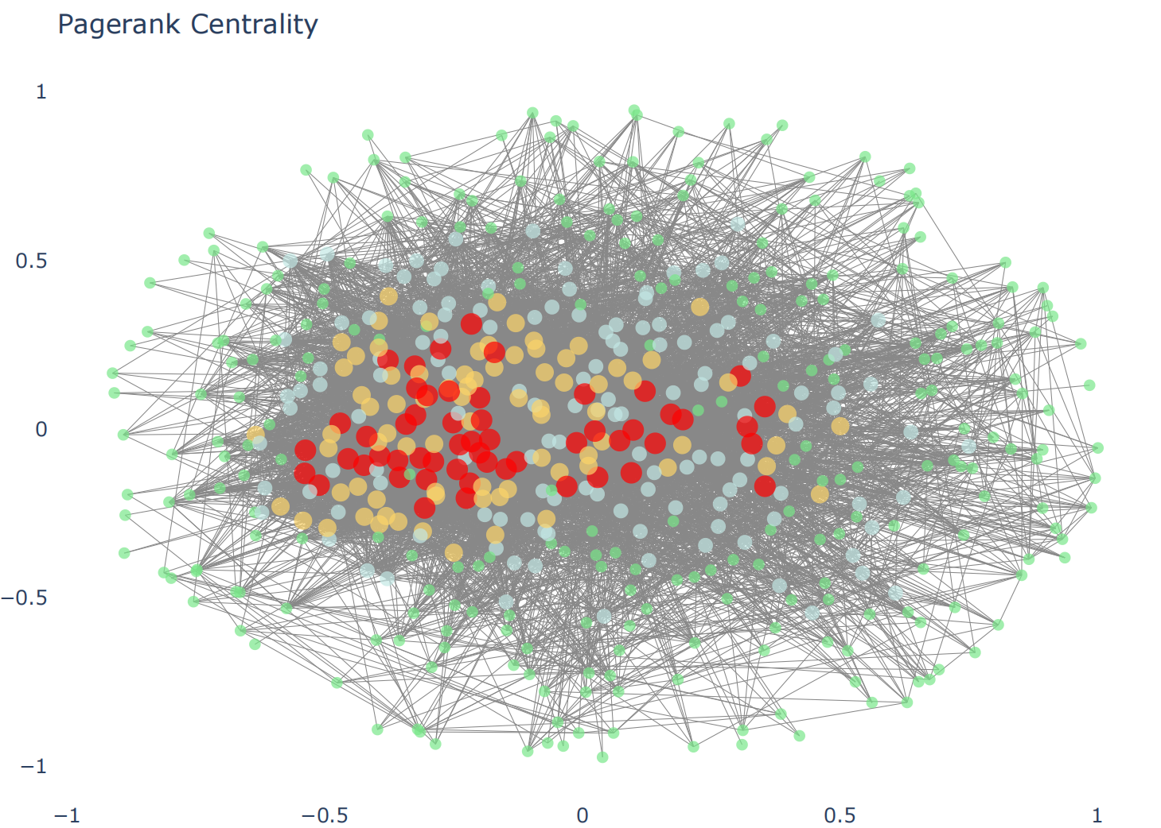
Node Centrality
Degree Centrality
Eigenvector Centrality

Slide 15
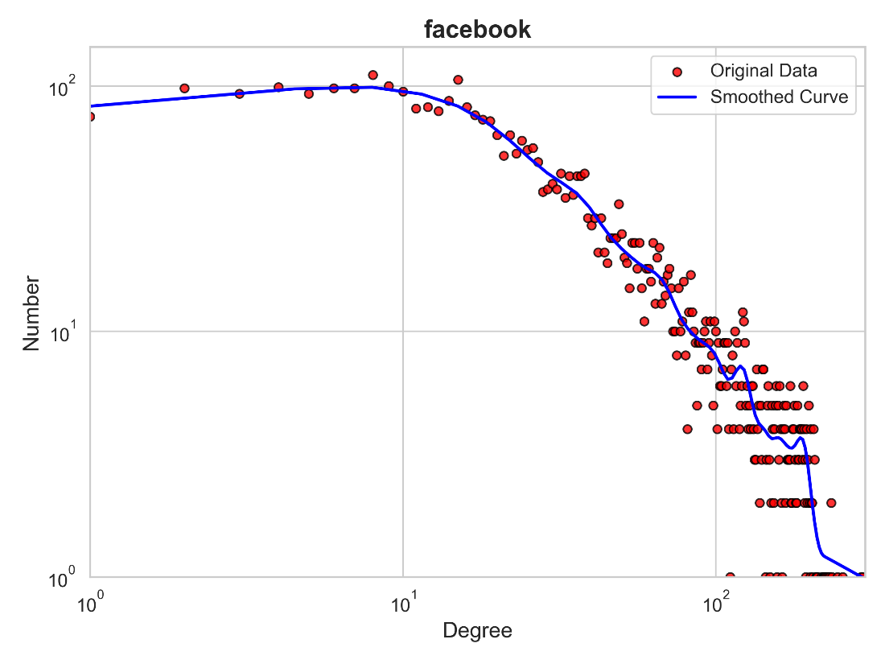
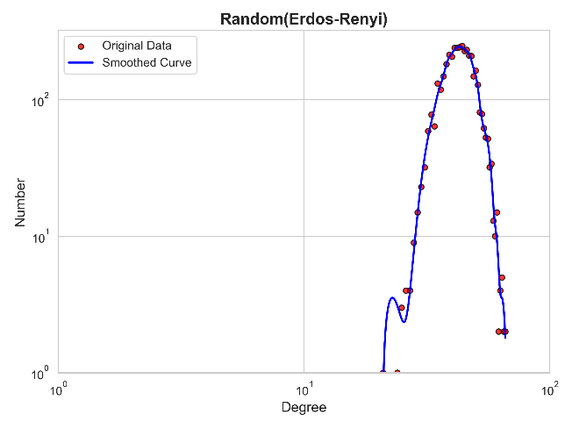
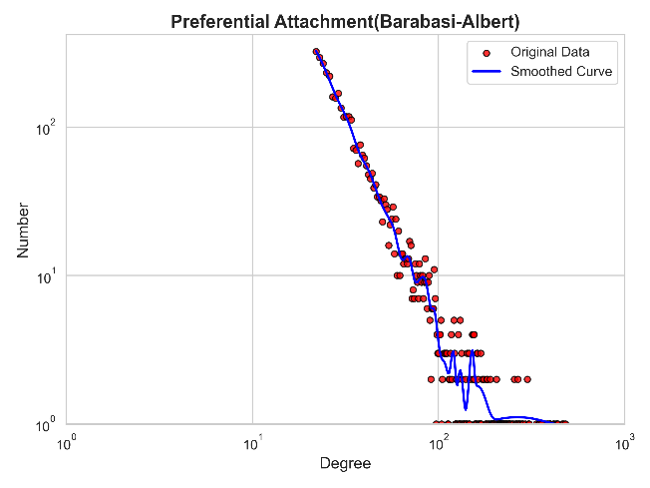
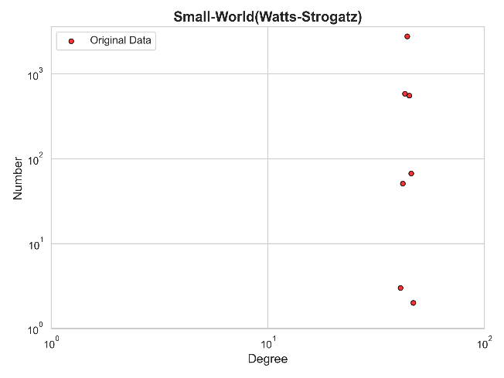
Metrics
 | Facebook | ER | BA | WS
Nodes | 4039 | 4039 | 4039 | 4039
Edges | 88234 | 88163 | 88374 | 88858
Clustering | 0.606 | 0.011 | 0.038 | 0.712
Avg Dist. | 3.692 | 2.606 | 2.512 | 4.148
Diameter | 8 | 4 | 4 | 7

Slide 16
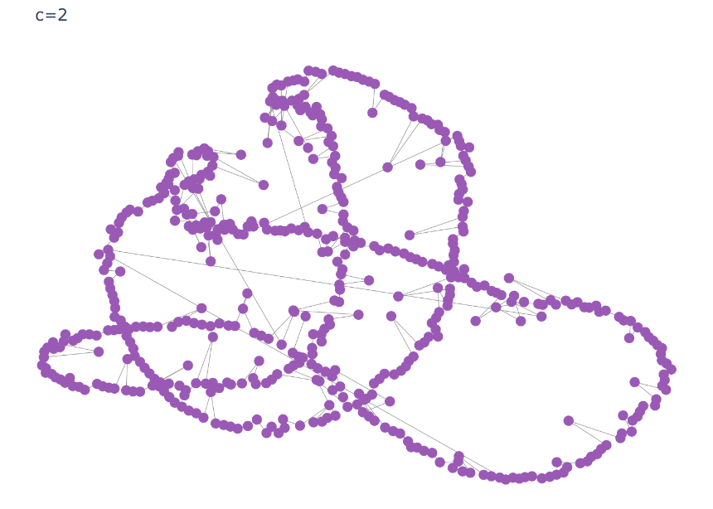
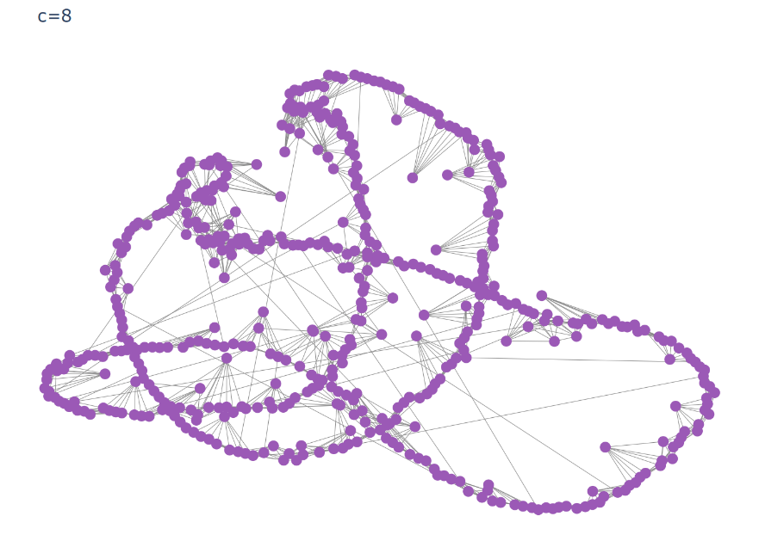

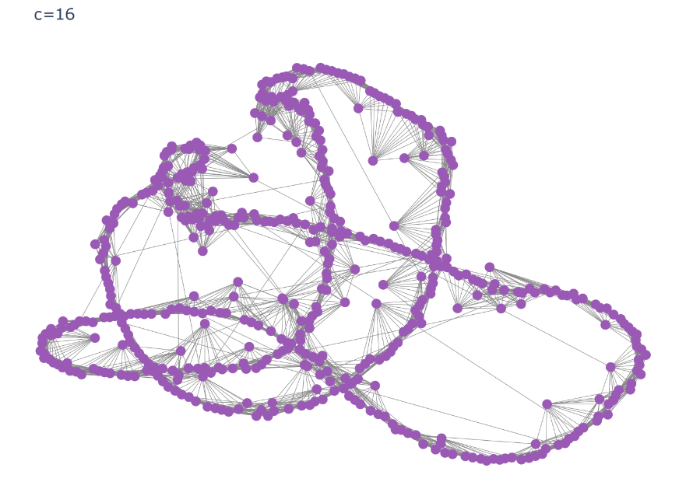
Network Structure Evolution
Use WS model for simulation
C = 4
C = 16
C = 2
C = 8

Slide 17
Link Prediction

Slide 18
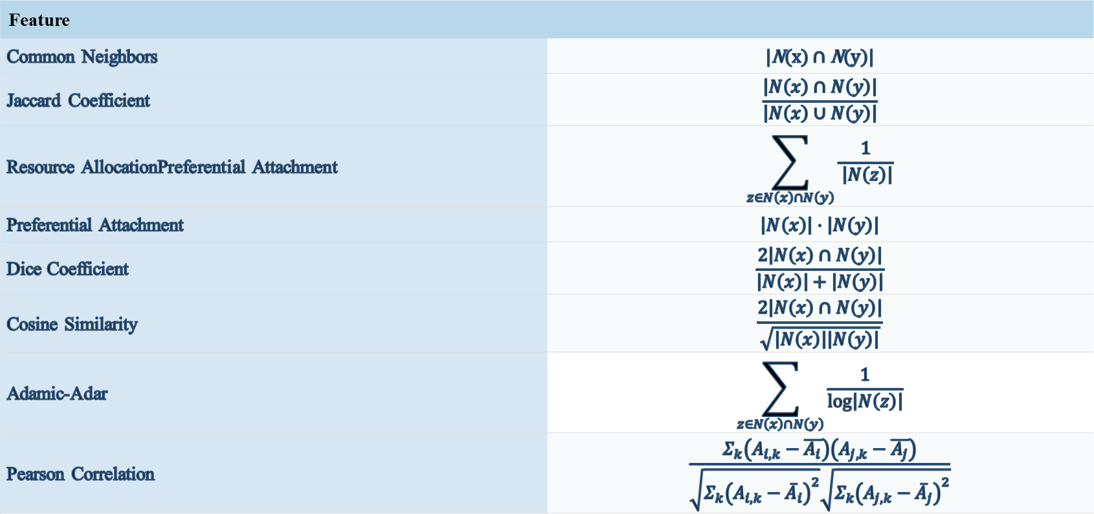
Link prediction
The features for each pair of nodes are calculated, and then classic machine learning classification models (such as Decision Tree, KNN, Naive Bayes, Logistic Regression, SVM, and MLP) are used.
Feature
Common Neighbors | |N(x) ∩ N(y)|
Jaccard Coefficient | $$\frac{\left|N\left(x\right)∩N\left(y\right)\right|}{\left|N\left(x\right)∪N\left(y\right)\right|}$$
Resource AllocationPreferential Attachment | $$\sum_{z∈N\left(x\right)∩N\left(y\right)}{\frac{1}{\left|N\left(z\right)\right|}}$$
Preferential Attachment | $$\left|N\left(x\right)\right|⋅\left|N\left(y\right)\right|$$
Dice Coefficient | $$\frac{2\left|N\left(x\right)∩N\left(y\right)\right|}{\left|N\left(x\right)\right|+\left|N\left(y\right)\right|}$$
Cosine Similarity | $$\frac{2\left|N\left(x\right)∩N\left(y\right)\right|}{\sqrt{\left|N\left(x\right)\right|\left|N\left(y\right)\right|}}$$
Adamic-Adar | $$\sum_{z∈N\left(x\right)∩N\left(y\right)}{\frac{1}{\log\left|N\left(z\right)\right|}}$$
Pearson Correlation | $$\frac{Σ_{k}\left(A_{i,k}−\overline{A_{i}}\right)\left(A_{j,k}−\overline{A_{j}}\right)}{\sqrt{Σ_{k}{\left(A_{i,k}−{\overline{A}}_{i}\right)}^{2}}\sqrt{Σ_{k}{\left(A_{j,k}−{\overline{A}}_{j}\right)}^{2}}}$$

Slide 19
Link prediction
Decision Tree, KNN, Naive Bayes, Logistic Regression, SVM, and MLP are used as classification models for feature processing.
Positive edges: Extracted from the existing edges in the graph. Negative edges: The edges that do not exist in the graph
To ensure an equal number of positive and negative edges, the negative edges are randomly sampled and merged with the positive edges to form the training data.
Trained and predicted on the Facebook dataset (Test) Trained and predicted on the CORA dataset (Test)
Facebook dataset | AUC | AP
Decision Tree | 0.834998 | 0.873852
KNN | 0.893061 | 0.894446
Naive Bayes | 0.898779 | 0.926500
Logistic Regression | 0.910104 | 0.934840
SVM | 0.899591 | 0.928521
MLP | 0.916813 | 0.938999
Node2vec+Logistic | 0.990051 | 0.985951
CORA dataset | AUC | AP
Decision Tree | 0.929871 | 0.903929
KNN | 0.907618 | 0.876139
Naive Bayes | 0.679915 | 0.789205
Logistic Regression | 0.851754 | 0.884712
SVM | 0.709225 | 0.814020
MLP | 0.938992 | 0.924284
Node2vec+Logistic | 0.861507 | 0.893164

Slide 20
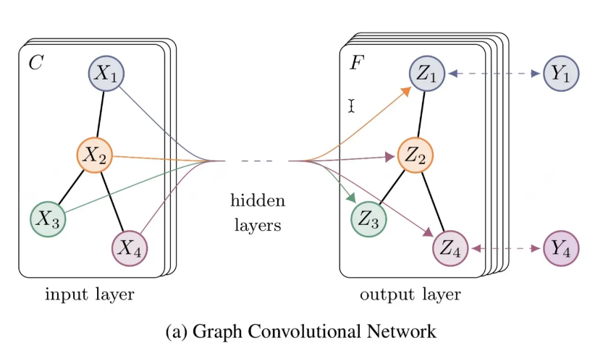
Graph Convolutional Networks
1. Capturing graph structure information: Able to directly process graph data and capture the relationships between nodes
2. Local feature aggregation: Updates node features by aggregating information from neighboring nodes
3. Efficient computation: Shared parameters reduce computational cost, making it suitable for large-scale graph data

Slide 21
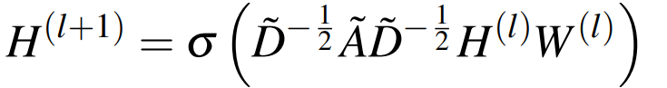
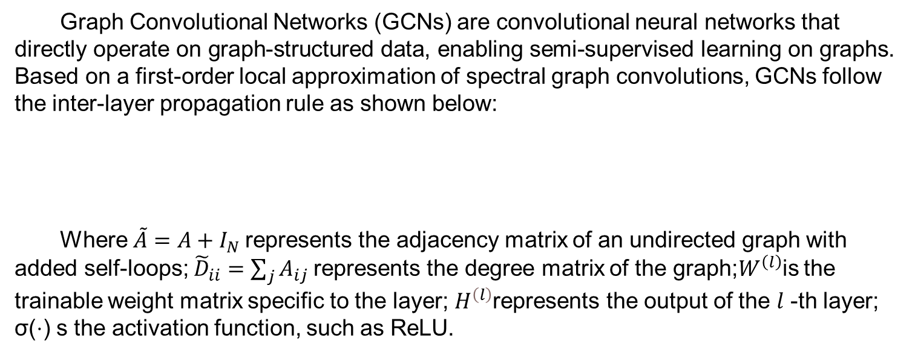
Graph Convolutional Networks
Graph Convolutional Networks (GCNs) are convolutional neural networks that directly operate on graph-structured data, enabling semi-supervised learning on graphs. Based on a first-order local approximation of spectral graph convolutions, GCNs follow the inter-layer propagation rule as shown below:
Where$\tilde{A}=A+I_{N}$ represents the adjacency matrix of an undirected graph with added self-loops; ${\tilde{D}}_{ii}=\sum_{j}{A_{ij} }$represents the degree matrix of the graph;$W^{\left(l\right)}$is the trainable weight matrix specific to the layer; $H^{\left(l\right)}$represents the output of the $l$ -th layer; σ(⋅) s the activation function, such as ReLU.

Slide 22
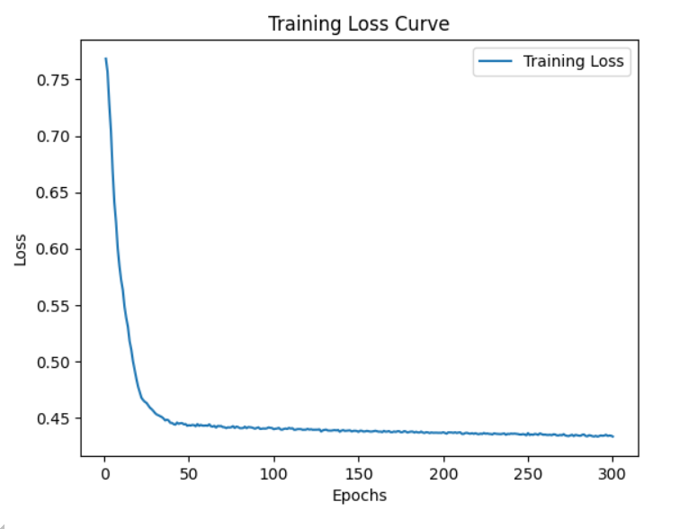
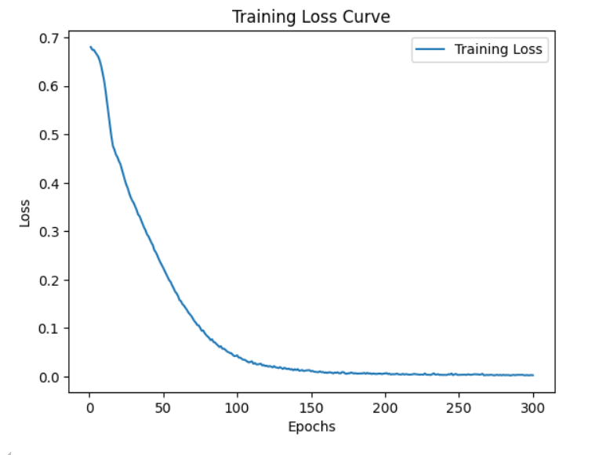
Graph Convolutional Networks
On Facebook dataset
On CORA dataset
Total nodes: 4039 Total edges: 88234
Training edges (positive): 52941 Training edges (negative): 52941 Validation edges (positive): 8823 Validation edges (negative): 8823
Test edges (positive): 26470 Test edges (negative): 26470
Total nodes: 2708 Total edges: 5278
Training edges (positive): 3168 Training edges (negative): 3168
Validation edges (positive): 527 Validation edges (negative): 527
Test edges (positive): 1583 Test edges (negative): 1583
Best Test ROC AUC: 0.975404
Best Test AP: 0.971985
Best Test ROC AUC: 0.849601
Best Test AP: 0.847957

Slide 23
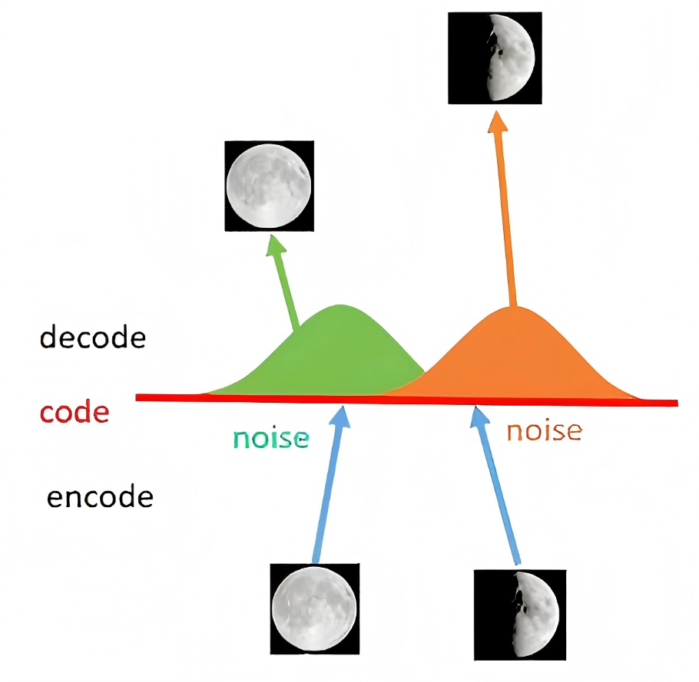
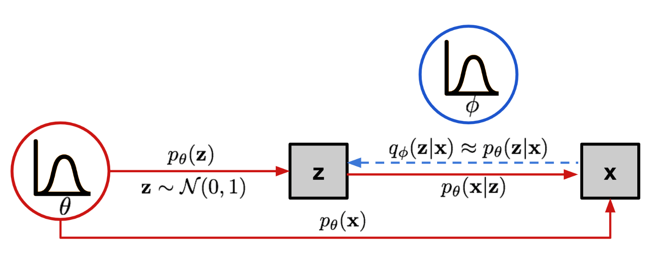
Variational Graph Auto-Encoders
VAE (Variational Auto-Encoders)

Slide 24
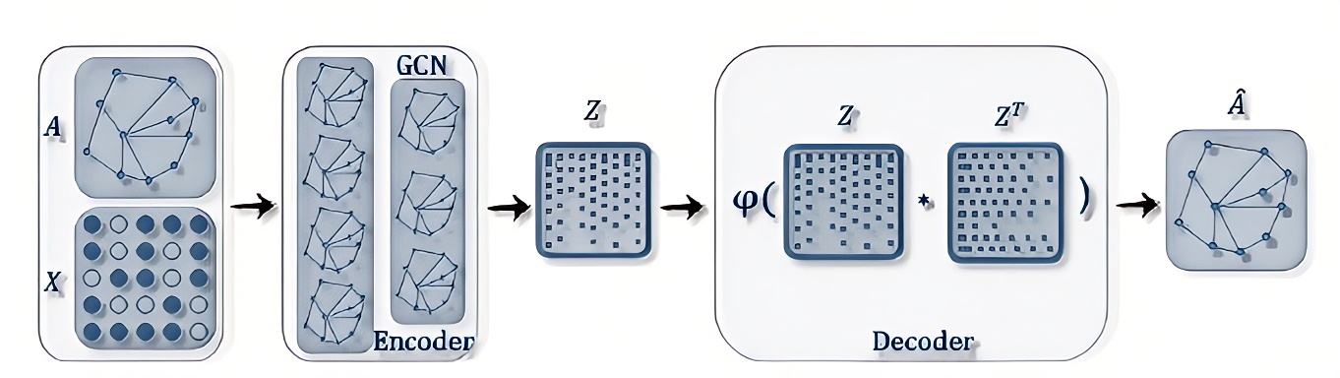
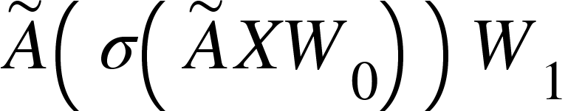
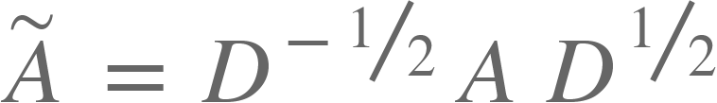
Variational Graph Auto-Encoders
VGAE (Variational Graph Auto-Encoders)

Slide 25
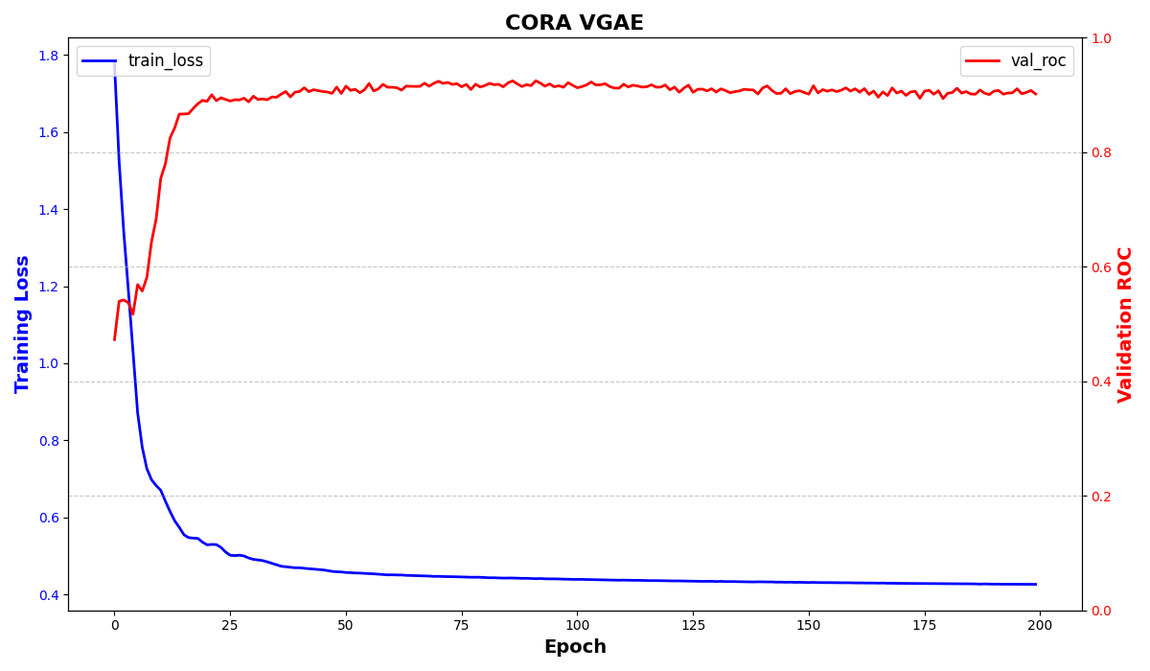
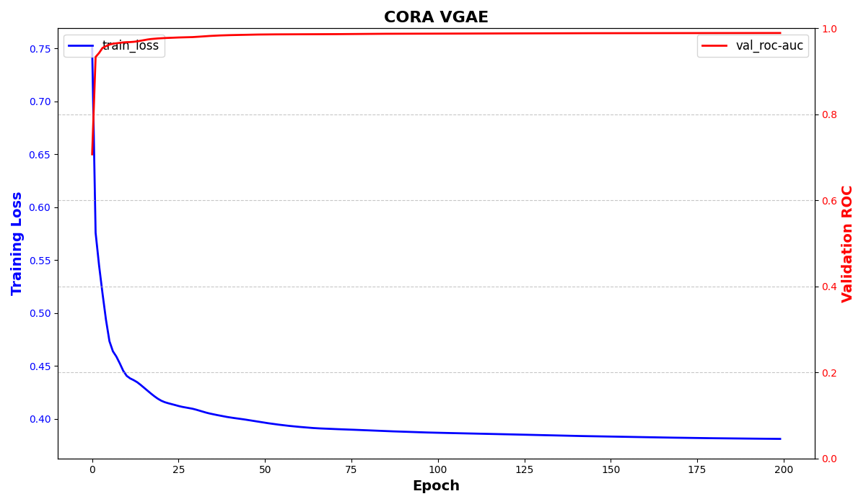
Variational Graph Auto-Encoders
Experiment Results
 | CORA | Facebook
ROC-AUC | 0.910 | 0.981
AP | 0.922 | 0.988
ACC | 0.556 | 0.771

Slide 26
Node Classification

Slide 27
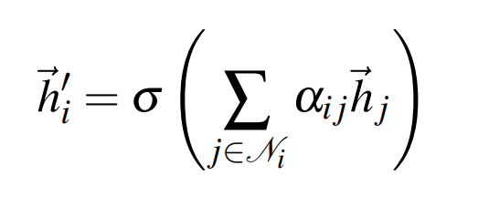
Node classification
Graph Attention Networks (GAT)
Graph Attention Networks (GAT) introduce a masked self-attention mechanism to address the limitations of graph convolutional methods or their approximations. In the network, the feature of node j propagates according to the following formula:
Where $α_{ij}$=${softmax}_{j}$ ($e_{ij}$)= $\frac{exp⁡(e_{ij})}{\sum_{k∈N_{i}}{e_{ik}}}$ and $e_{ij}$ denotes LeakyReLU (${\vec{a}}^{′}$[W${\vec{h}}_{i}$||W${\vec{h}}_{j}$]); $\vec{a}$ denotes the role of a single-layer feedforward neural network; and W denotes the trainable weight matrix, same meaning as $W^{l}$in GCN.

Slide 28
Node classification
Performance Evaluation:
Accuracy:
Accuracy=$\frac{\text{Number} \text{of} \text{Correctly} \text{Classified} \text{Samples}}{\text{Total} \text{Number} \text{of} \text{Samples}}$
Negative Log-Likelihood Loss （Loss）:
Loss=-$\frac{1}{N}\sum_{i=1}^{N}{log⁡({\hat{y_{i}}}_{{,y}_{i}})}$
${\hat{y_{i}}}_{{,y}_{i}}$ is the predicted probability (logarithmic probability) of the model for the true class of the i-th training sample.
N is the number of nodes in the training set.

Slide 29
Node classification
Cora dataset
 | LOSS |  | ACCURACY
 | GCN | GAT | GCN | GAT
100(EPOCH) | 0.06 | 0.81 | 0.79 | 0.81
200(EPOCH) | 0.04 | 0.77 | 0.78 | 0.80
300(EPOCH) | 0.02 | 0.71 | 0.79 | 0.79
400(EPOCH) | 0.02 | 0.69 | 0.79 | 0.80
500(EPOCH) | 0.01 | 0.61 | 0.80 | 0.80
BEST EPOCH | GCN performs best in 438epoch,acc=0.81 |  | GAT performs best in 51epoch,acc=0.82
"From the results, we can see that the performance of GCN is slightly better than GAT. However, in our experiments, it was observed that GCN reached its peak accuracy at 438 iterations, while GAT reached its peak at 51 iterations."

Slide 30
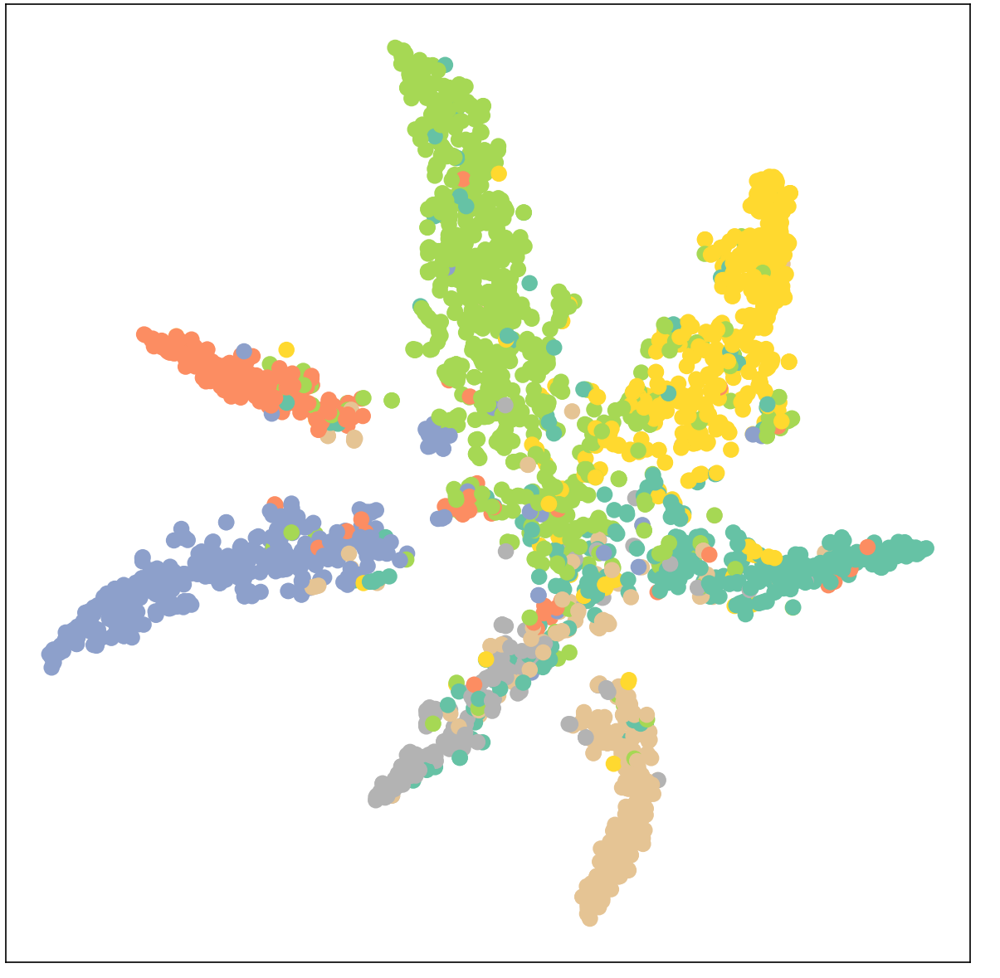
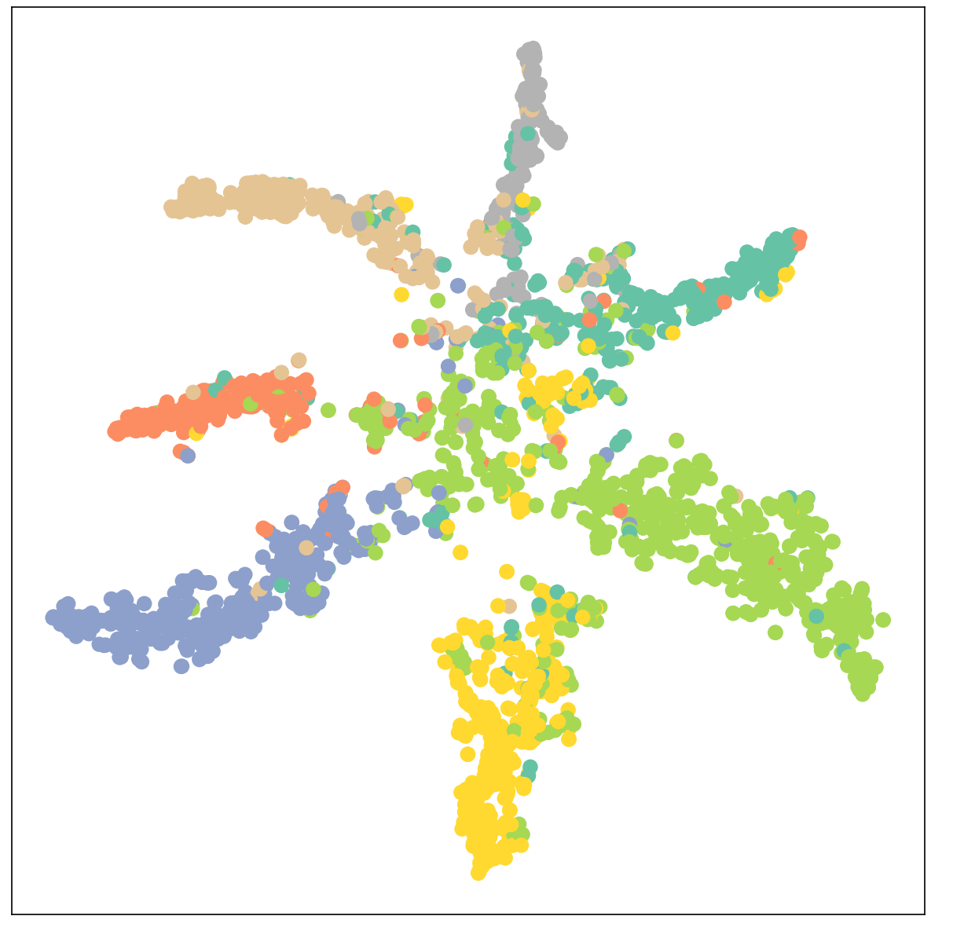
Node classification
Classification results
GCN
GAT

Slide 31
Node classification
Facebook dataset
 | LOSS |  | ACCURACY
 | GCN | GAT | GCN | GAT
10(EPOCH) | 0.57 | 1.67 | 0.92 | 0.85
20(EPOCH) | 0.25 | 1.28 | 0.95 | 0.92
30(EPOCH) | 0.15 | 1.04 | 0.95 | 0.94
40(EPOCH) | 0.13 | 0.93 | 0.96 | 0.94
50(EPOCH) | 0.13 | 0.83 | 0.96 | 0.96
BEST EPOPOCH | GCN performs best in 26epoch，acc=0.97 |  | GAT performs best in 48epoch，acc=0.96

Slide 32
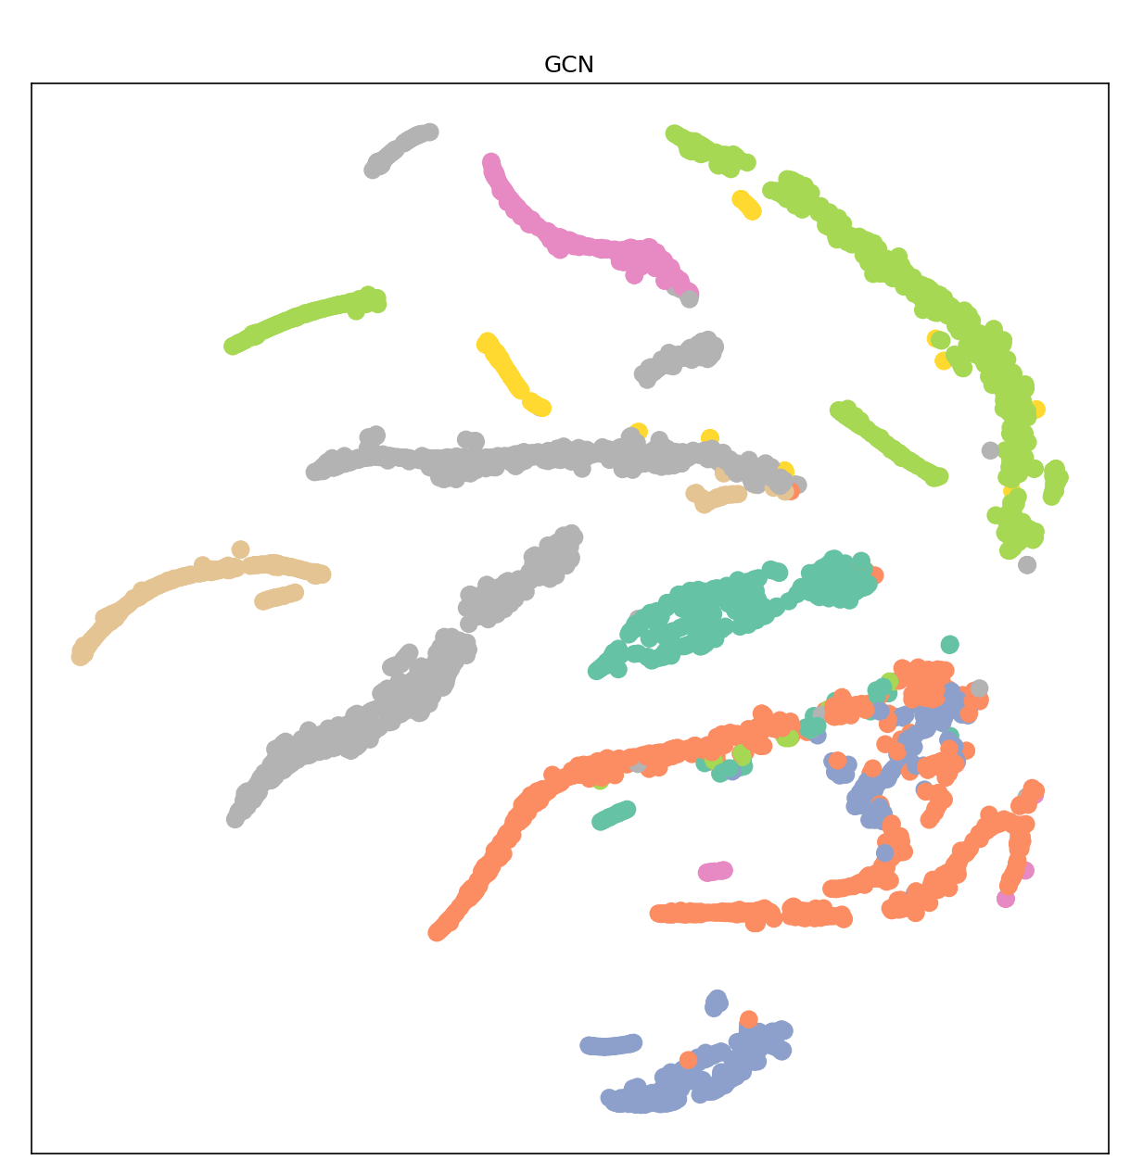
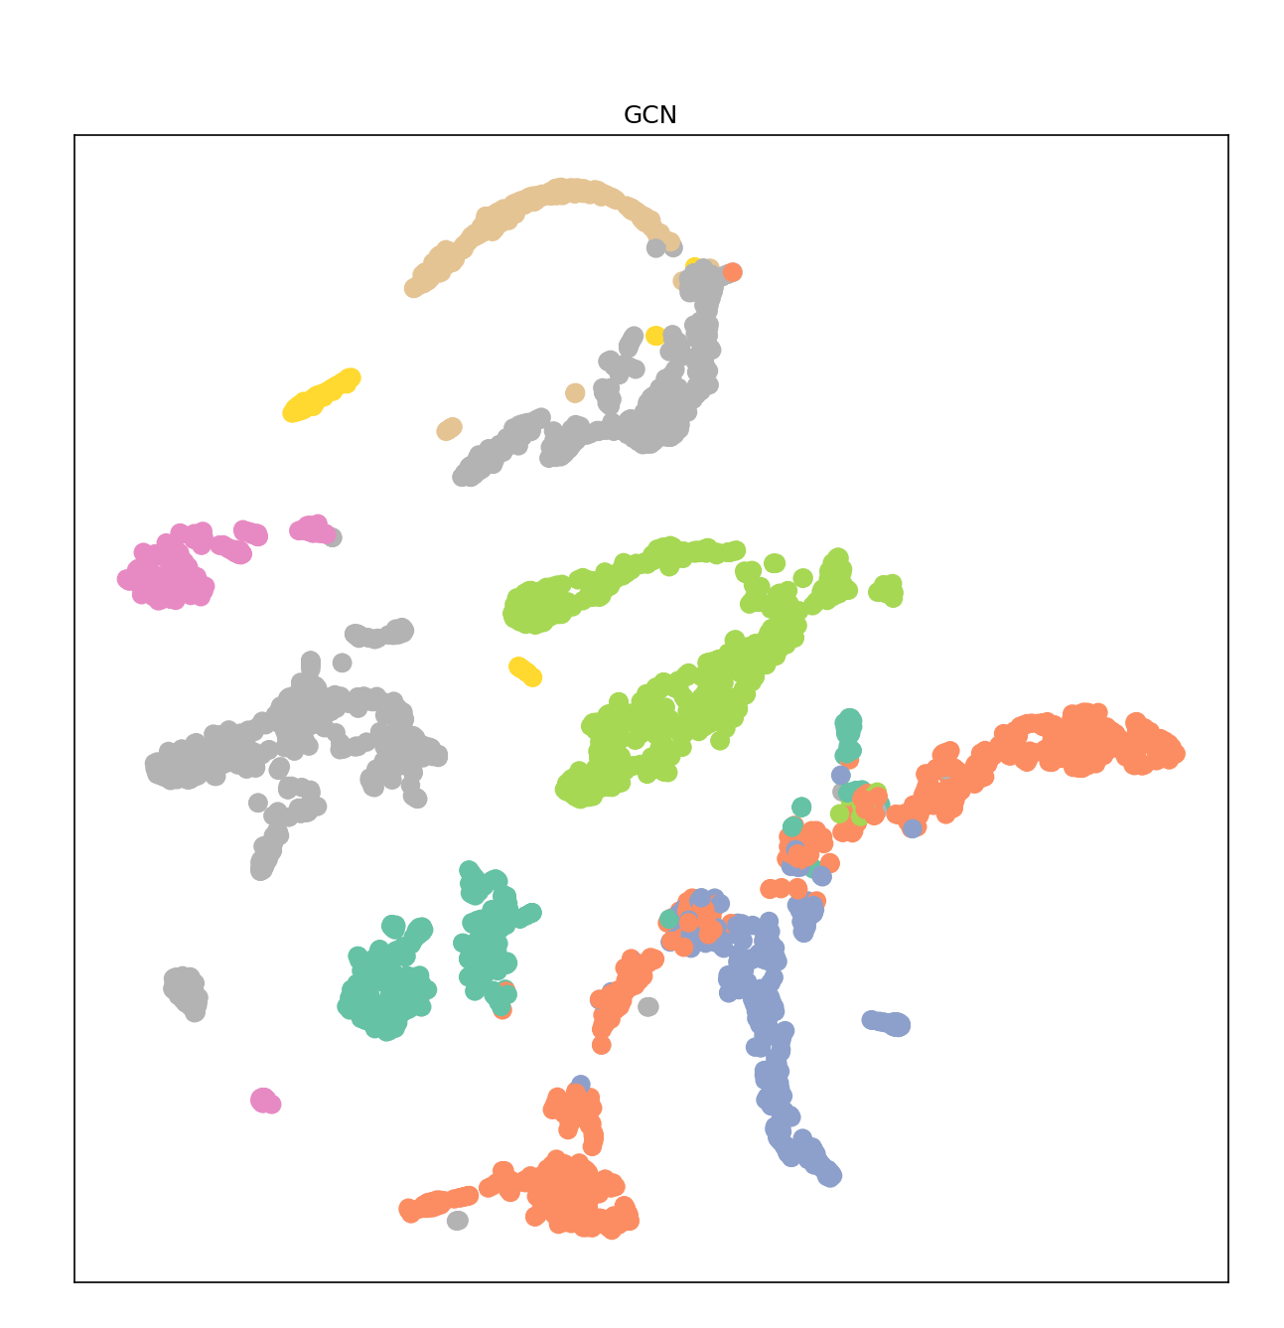
Node classification
Classification results
GCN
GAT

